Slide 1
Experimental Investigation and Numerical CFD Assessment of a Thermodynamic Breakup Model for Superheated Sprays with Injection Pressure up to 700 Bar
Francesco Duronio¹, Angelo De Vita^{1,2}, Alessandro Montanaro² and Luigi Allocca²
¹ Industrial Engineering, Information and Economics Department, Università degli Studi dell’Aquila, Piazzale Ernesto Pontieri, Monteluco di Roio, 67100 L’Aquila, Italy
² Consiglio Nazionale delle Ricerche, Istituto di Scienze e Tecnologie per l’Energia e la Mobilità Sostenibili (STEMS), Via G. Marconi 4, 80125 Napoli, Italy
Fluids, 2023, 8, 155. https://doi.org/10.3390/fluids8050155
202050869 Yechan Seo
Oct. 31st, 2023

Slide 2
1. Introduction

Slide 3
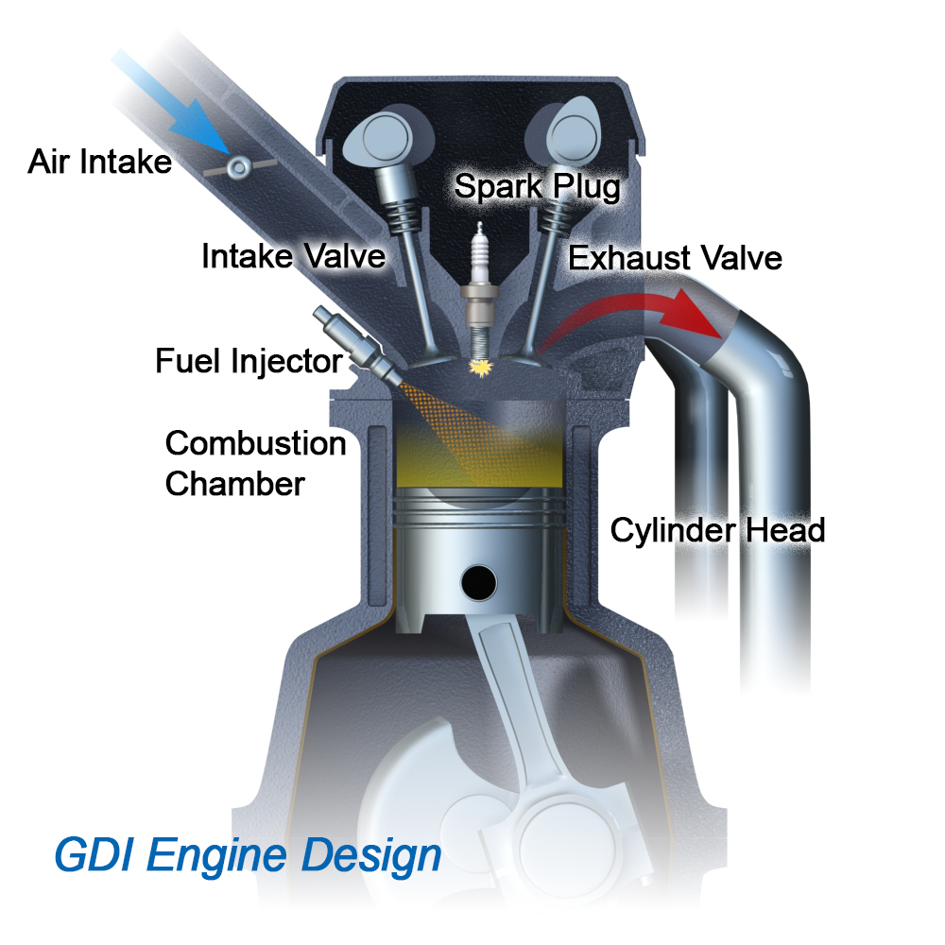
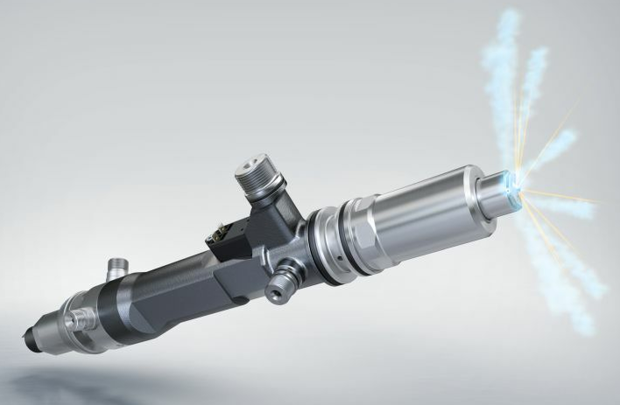
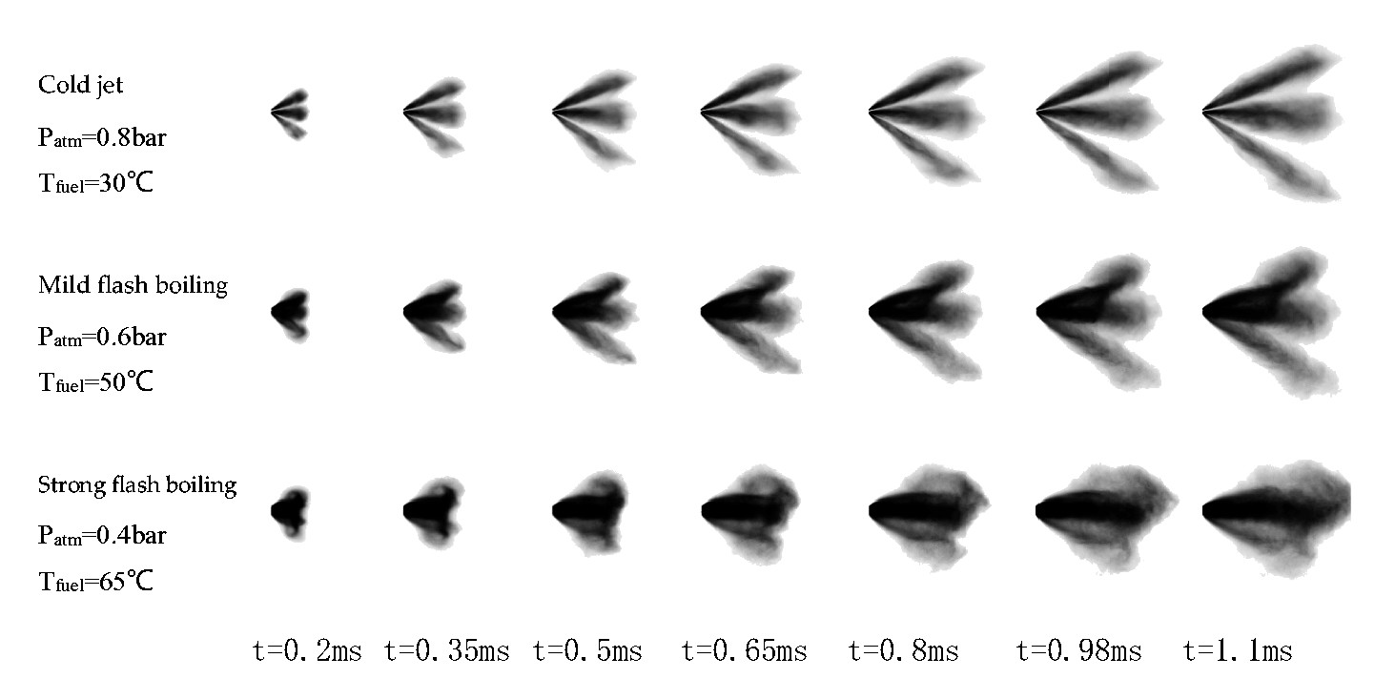
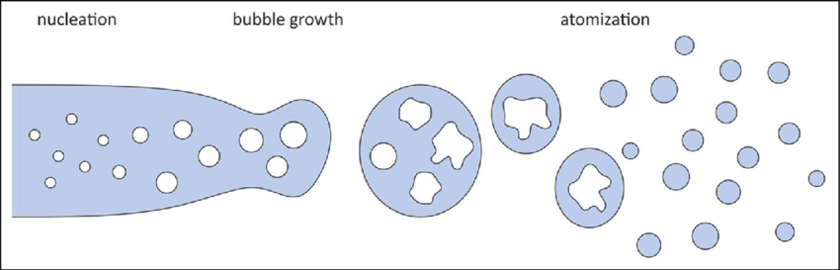
Introduction
high injection pressure
aerodynamic breakup + effervescent breakup
cold jet
flash boiling
Notes:
Among the gasoline engines used in vehicles, the GDI method, which injects fuel directly into the engine, has the advantage of downsizing the engine and improving combustion performance.
Fuel injectors used in this type of engine operate under high temperature and high pressure conditions. Flash boiling occurs after fuel injection due to high fuel temperature and low engine internal pressure, which cause vapor bubbles to form inside the fuel droplets. These bubbles affect the formation and breakup of droplets.
In particular, in the case of multi-hole injectors, spray collapse occurs due to interaction between fuel plumes, which cause wall impingement and soot generation.
In general, the Eulerian-Lagrangian method is applied to compute the injector spraying, and droplet formation can be simulated by applying Kelvin-Helmholtz, Rayleigh-Taylor instabilities, and Reitz-Diwakar model. However, in the case of flash boiling, effervescent breakup due to vapor bubbles should be applied additionally.

Slide 4
Introduction
This paper focuses on the investigation of high-pressure liquid sprays in both non-evaporative and flash boiling conditions performed with experimental and numerical methods.
The performance of the developed effervescent breakup model in simulating the behavior of high-pressure spray under flash boiling conditions was assessed.
The discussed CFD methodology was validated using the experimental images obtained using nonintrusive techniques.

Slide 5
2. Research Methodology

Slide 6
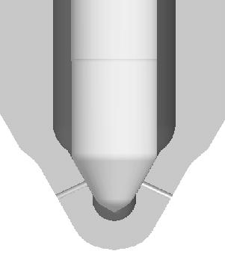
Experimental and numerical conditions
Principal features of the GDI injector
Spray shape | Circular
Nozzle type | VCO (valve-covered orifice)
Nozzle shape | Stepped-hole
Orifice length | 700 μm
Orifice diameter | 100 μm
L/D ratio | 7
Orifice drill angle | 35.5º / 45º
Full outer angle | 90º
Flow rate | 10.55 cc/s @ 100 bar
Discharge Coefficient | 0.737 @ 400 bar / 0.937 @ 700 bar
Investigated operating conditions
 | Case HP | Vase HP-fb | Case vHP | Case vHP-fb
Injection Pressure [bar] | 400 | 400 | 700 | 700
Fuel Temp. [K] | 293 | 363 | 293 | 363
Ambient Pressure [bar] | 1 | 0.2 | 1 | 0.2
Ambient Temp. [K] | 293 | 293 | 293 | 293
Notes:
A stepped-hole valve-covered orifice injector was used in this study.
Each HP and vHP cases are for 400 and 700 bar of injection pressure.
The fb means flash boiling, which added the effervescent breakup.

Slide 7
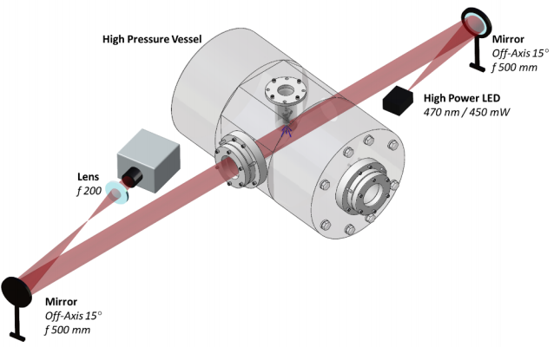
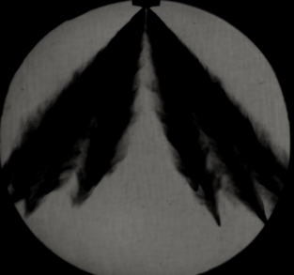
Experimental Equipment and Setup
High-speed camera (Photron FASTCAM SA4)
16,000 fps
Notes:
This shows the experimental setup, which applied the shadowgraph method.
And a high-speed camera was used for the visualization of injection sprays.

Slide 8
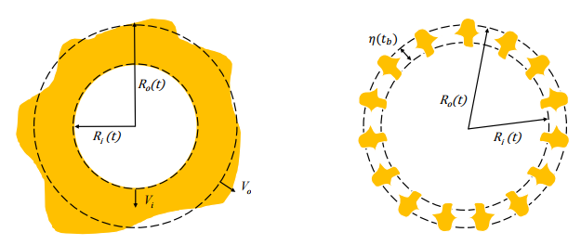
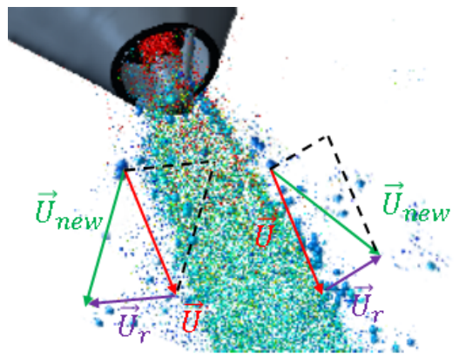
Computational Method
Eulerian-Lagrangian method
PISO algorithm
Turbulence model: RANS RNG k-ε model
Aerodynamic breakup: Reitz-Diwakar model
Effervescent breakup: UDF (fbBreakup)
Lagrangian framework physical submodels
Injection model | Flowrate + Discharge
Effervescent Breakup | fbBreakup
Aerodynamic Breakup | Reitz-Diwakar
Heat transfer | Ranz-Marshall
Vaporization | Frossling + Flash Boiling Vaporization
Collision | No Time Counter (NTC)
Coalescence | Post and Abraham
Dispersion | O’Rourke
bubble growth
Bubble-droplet system
after the bubble breakup,
update the droplet velocity
Notes:
For the computational method, in basically, the Eulerian-Lagrangian hybrid method was solved with PISO algorithm.
And to compute the aerodynamic breakup of the fuel, Reitz-Diwakar model was applied, and for the effervescent breakup, user defined function was used.
The UDF is about the growth of the vapor bubble inside the droplet, which will be broken up when the growth rate meet the critical value.
And after the bubble breakup, the droplet velocity will be updated.

Slide 9
Discussion of the Results

Slide 10
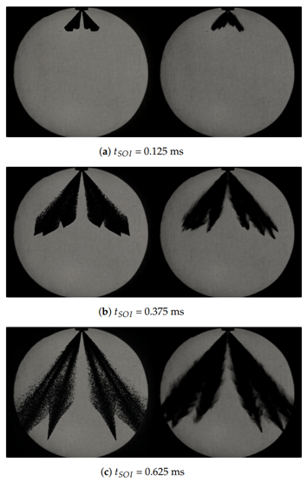
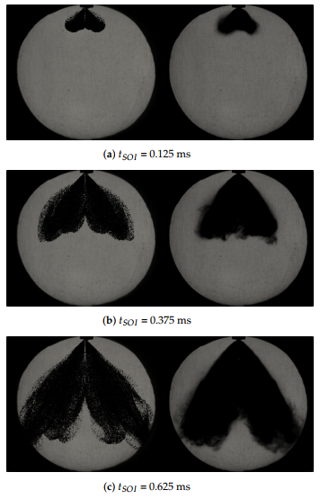
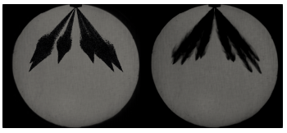
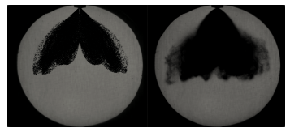
Validation with Shadowgraph Acquisitions
CFD
shadowgraph
CFD
shadowgraph
CFD
shadowgraph
case HP
CFD
shadowgraph
CFD
shadowgraph
CFD
shadowgraph
case HP-fb
CFD
shadowgraph
CFD
shadowgraph
case vHP
case vHP-fb
Notes:
The experimental results were used to validate the CFD simulation.
Figures show the comparison of the CFD spray shape and the shadowgraph images at different temporal instants.
The agreement between experiments and simulations is quite good for each case.
The single plumes of the spray are clearly recognizable from the case vHP, but for the flash boiling case, the plumes interact with each other.
This is an effect of the strong effervescent breakup.

Slide 11
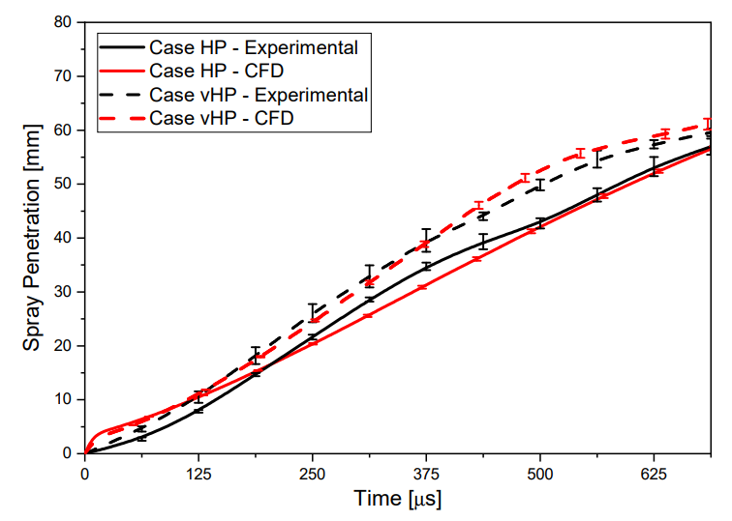
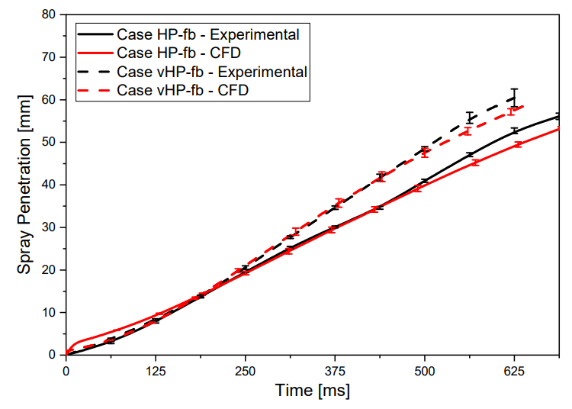
Validation with Shadowgraph Acquisitions
Notes:
A quantitative validation was performed comparing the spray penetration measured from the results of experiments and simulations.
The penetrations measured from the experimental images and those computed from the simulations are in quite good agreement, and the differences are almost limited within the uncertainty bars.

Slide 12
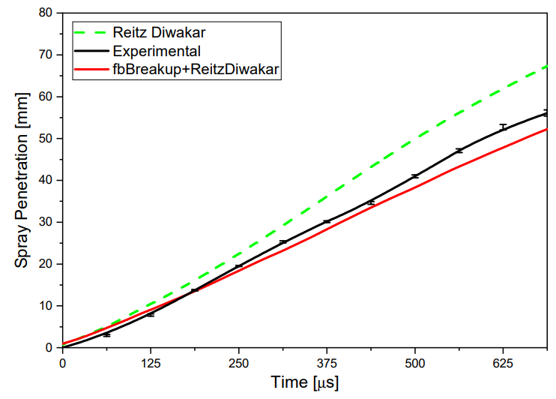
Insight about the Flash Boiling Breakup Model
aerodynamic
overestimated
aerodynamic + flash boiling
case HP-fb
Notes:
The penetration lengths computed using Reitz-Diwakar and fbBreakup+Reitz-Diwakar breakup models are compared to assess the benefit of using the effervescent breakup model.
The penetration length was overestimated using only the aerodynamic breakup model.

Slide 13
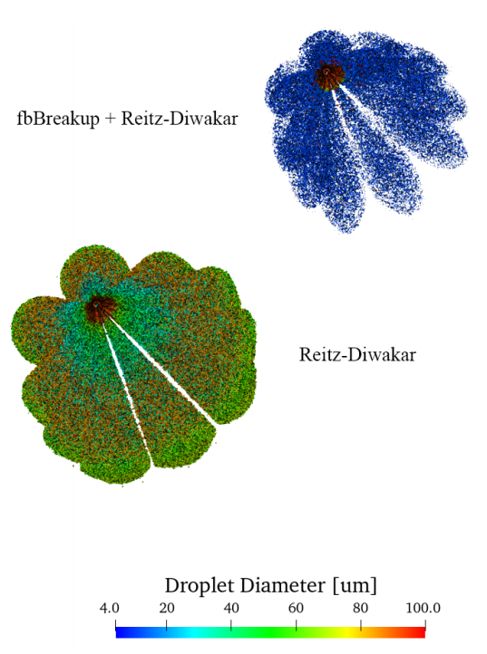
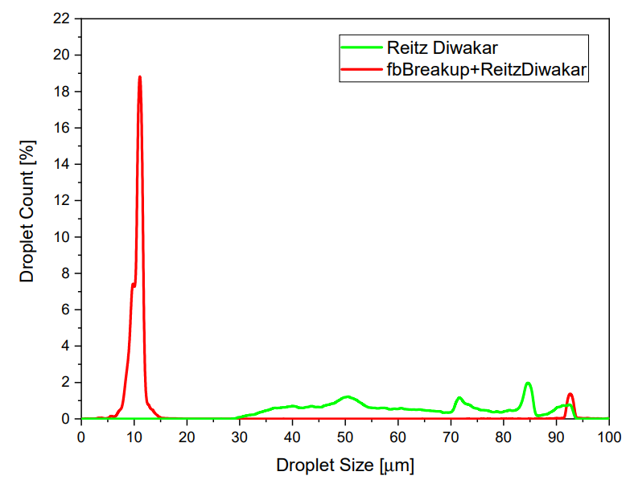
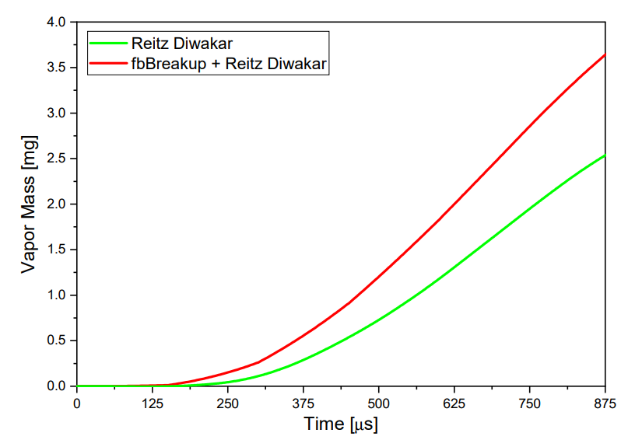
Insight about the Flash Boiling Breakup Model
aerodynamic + flash boiling
~20%
aerodynamic
case HP-fb
Notes:
The droplet size distribution also compared with Reitz-Diwakar and fbBreakup+Reitz-Diwakar breakup models.
The effervescent breakup model predicts droplets smaller than what computed using only the Reitz–Diwakar model.
And the droplets obtained from the fbBreakup+Reitz–Diwakar model have an average value equal to approximately 10 µm while using the Reitz–Diwakar model, droplet diameter ranges between 40 µm–80 µm without a pseudo-average value.
After 750 us, the fuel evaporated is 20% lower.

Slide 14
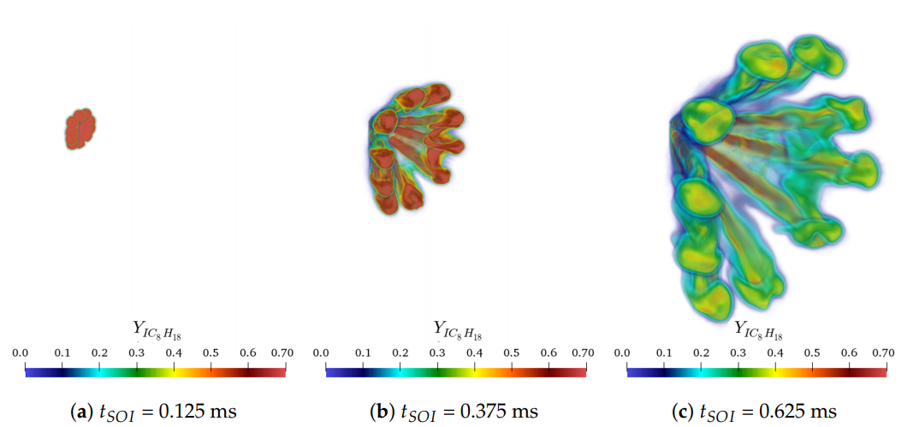
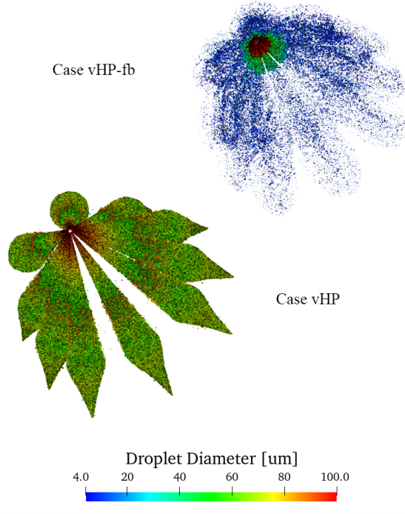
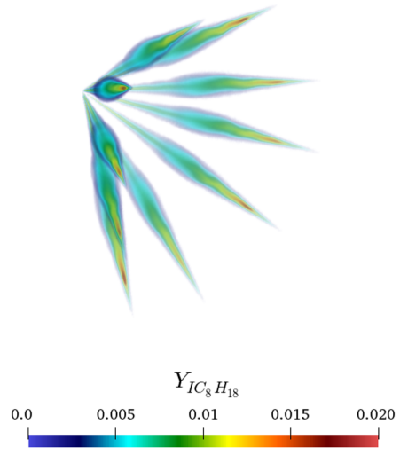
Details about the Spray Methodology
Effect of the flash boiling
fuel mass fraction for vHP-fb
fuel mass fraction for vHP
Notes:
After assessing the accuracy of CFD results with experiments, the spray characteristics was analyzed with the simulation results.
The plumes of the ﬂashing spray exhibit the interaction typical of a ﬂash-boiling spray and are composed by smaller droplets.
The case of the flash boiling model, vaporization process appears around the core of the plume, and fuel distributed compactly.

Slide 15
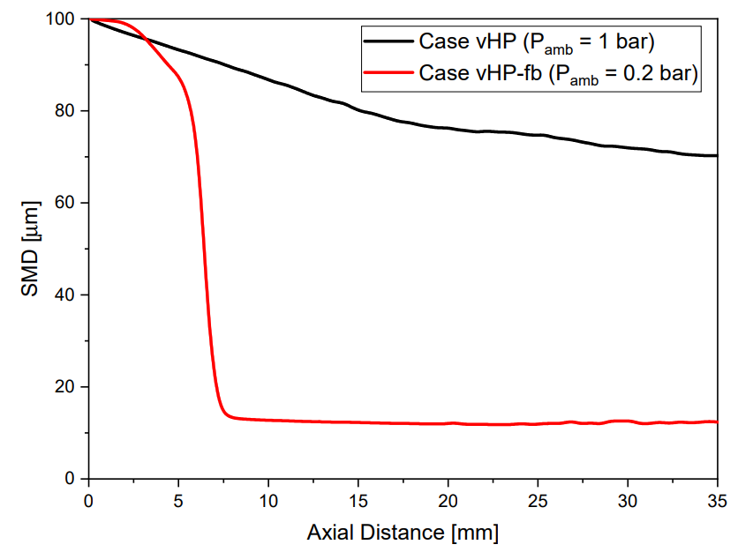
Details about the Spray Methodology
Effect of the flash boiling
Droplet size decreased
due to the effervescent breakup
Notes:
The effervescent breakup strongly inﬂuences the morphology of the spray issued in the ﬂash boiling condition.
At a distance between 5 and 10 mm, the effervescent breakup reduces the droplet size dramatically.

Slide 16
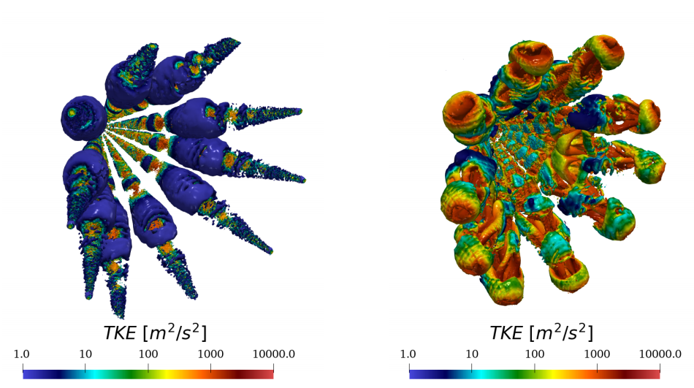
Details about the Spray Methodology
Effect of the flash boiling
Q-criterion iso-surface
case vHP
case vHP-fb
higher turbulence > higher air entrainment and mixing
Notes:
The Q-criterion iso-surface shows the turbulent kinetic energy distribution.
With the flash boiling, the turbulence increases around the spray plume.
Due to the rotation of the flow, air entrainment increases and fuel mixing with air increases.

Slide 17
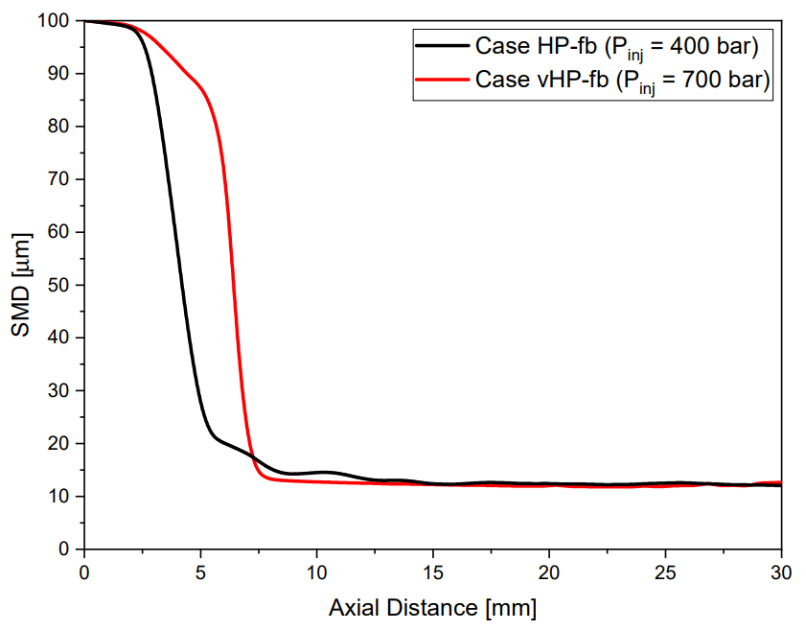
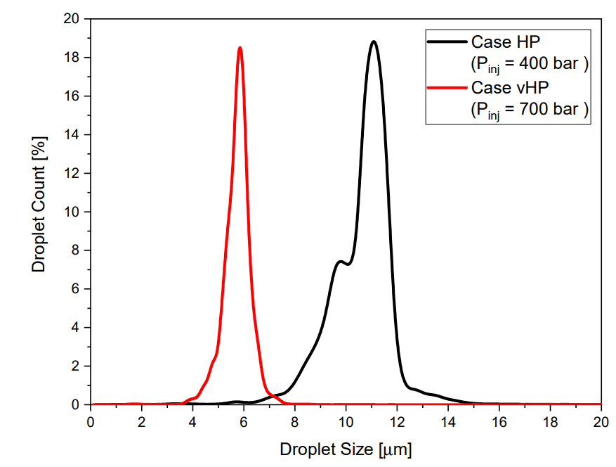
Details about the Spray Methodology
Effect of the injection pressure
higher injection pressure > higher momentum
Notes:
Due to the higher injection pressure, the jet momentum increases and extend the flash boiling breakup length.
Therefore, the more downstream flash boiling happens.
And as a result, the spray droplet size decreases.

Slide 18
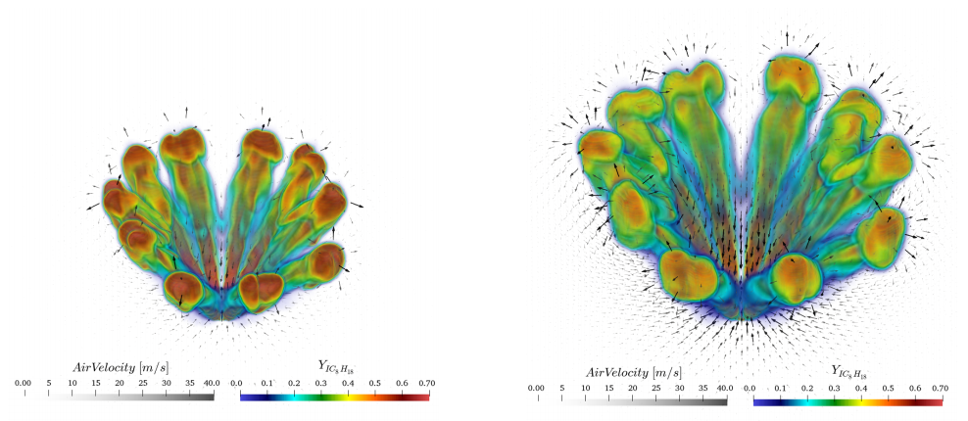
Details about the Spray Methodology
Effect of the injection pressure
higher air entrainment > avoiding the pressure reduction
and spray collapse
case HP-fb
case vHP-fb
Notes:
In addition, the higher injection pressure occurs the higher entrainment of the air to the center of the injector.
This avoid the pressure reduction at the central region, which decreasing the formation of the spray collapse.
And the entrainment of the air promotes the mixture formation.

Slide 19
Conclusions
The analysis of the injection process in flash boiling conditions of a spray issued from an innovative multi-hole operating at of ultrahigh injection pressure was carried out. Experimental images of the spray acquired using shadowgraph technique were exploited to validate Eulerian–Lagrangian simulations of nonevaporative and flash-boiling conditions. The flash-boiling conditions considered were simulated using an effervescent breakup model, based on vapor bubbles growing within the liquid droplets, together with Reitz– Diwakar aerodynamic breakup model.
The main outcomes can be summarized as follows:
Compared to an aerodynamic breakup model alone, the effervescent breakup model predicts droplets with smaller dimensions. The size distribution resemble a Gaussian distribution while, using Reitz–Diwakar model, the droplets’ diameters range from 40 µm to 80 µm.
The Reitz–Diwakar breakup model alone overestimates spray penetration when the constants used for non-evaporative conditions are used for ﬂash-boiling conditions.
The effervescent breakup reduces the droplet diameter of about one order of magnitude at a distance which, depending on the injection pressure, ranges between 5 and 10 mm from the injector tip.
Switching from non-evaporative to ﬂash-boiling conditions both the turbulent kinetic energy and the dimensions of the vortical structures increase.
For the investigated cases, plume-to-plume interaction is signiﬁcantly promoted by ﬂash-boiling occurrence, but it is not strong enough to cause spray collapse.
Adopting an elevated values of injection pressures spray-collapse is avoided, and so air/fuel interaction is promoted as well as ambient gas recirculation.

Slide 20
Thank you for listening!

